Slide 1
Project Plan
Tina, Tanja and Ryno

Slide 2
Overview
Our Research question
Our Dataset Description
General workflow
Our Journal entries

Slide 3
Our Research question
What is the effect of exposing the cyanobacteria to different light intensities?
Experiment: DDA label-free MS, 5 different light conditions, 4 replicates per light intensity
What proteins are differentially expressed?
Light intensity affect the cell size. Estimate the cell volume/surface ratio based on the cytosolic/membrane protein concentration ratio for different light conditions

Slide 4
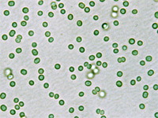
CyanoBacteria Proteome
Cyanobacteria are photosynthetic prokaryotes - Biofuel potential
Over 3000 protein-coding genes (Synechocystis)

Slide 5
General Flow
MSConvert to convert the raw data into mzxml format for alignment of retention time - 20 .d files
Fragment spectrum library search for identification
MaxQuant for relative quantification of peptide peaks

Slide 6
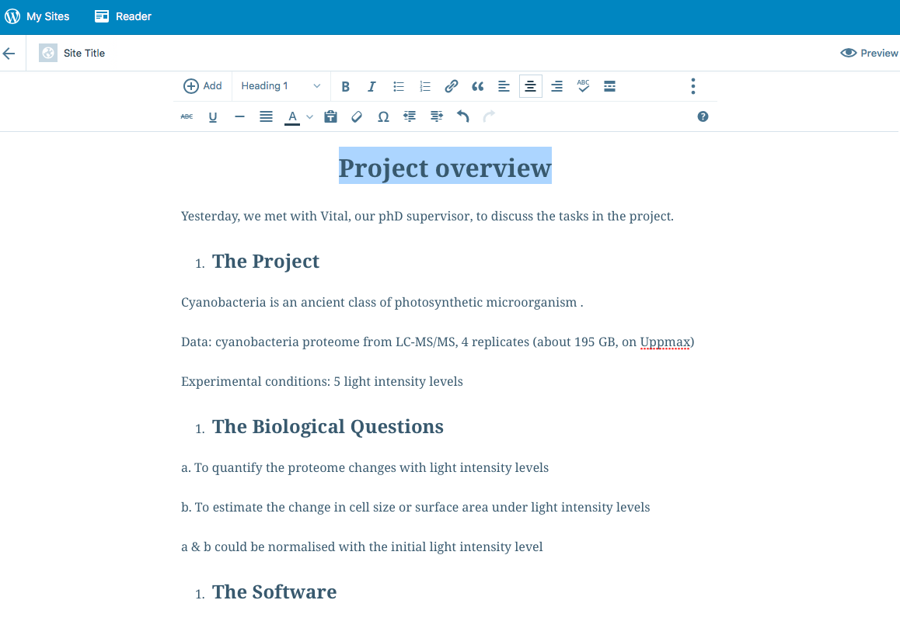
Tina Journal
Visit the wordpress site: https://tianlinkth.wordpress.com

Slide 7
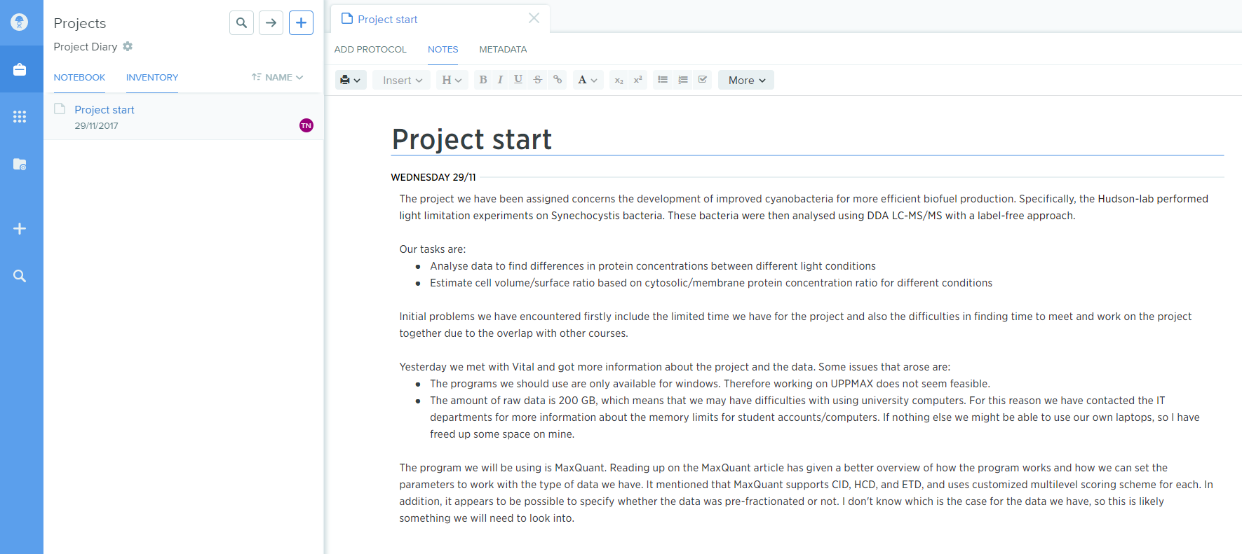
Tanja Journal
https://benchling.com/s/etr-F71fKMstJge1kLhz5Oni

Slide 8
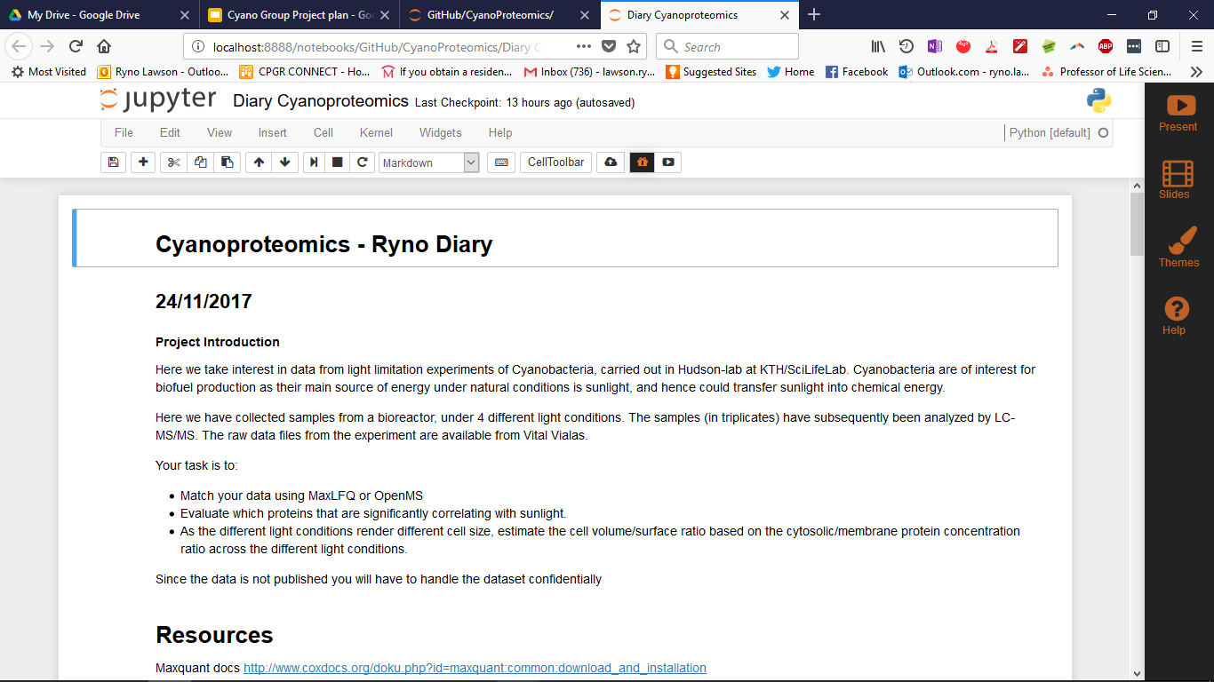
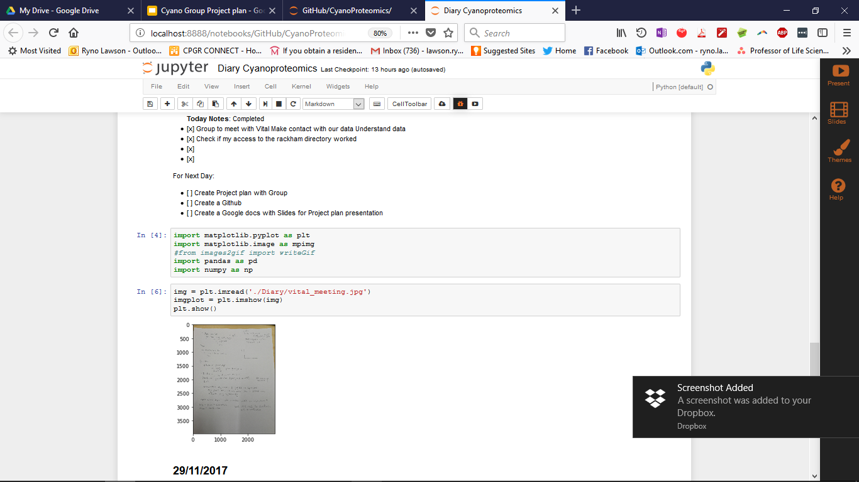
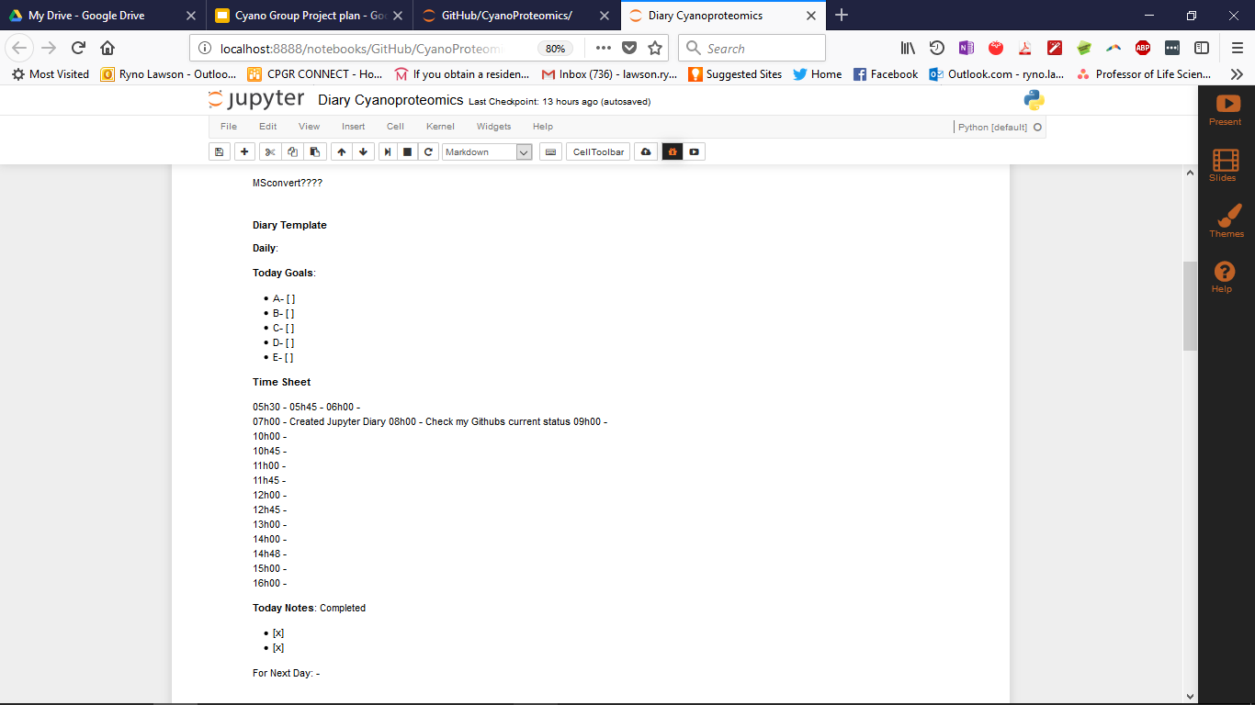
Ryno’s Journal
Jupyter Notebook
Live text and coding

